Slide 1
Figures for eyeballing
ONLY for fMRI group beh, Session 2
(No pilot data, no other sessions)
Started 31 Oct 2015

Slide 2
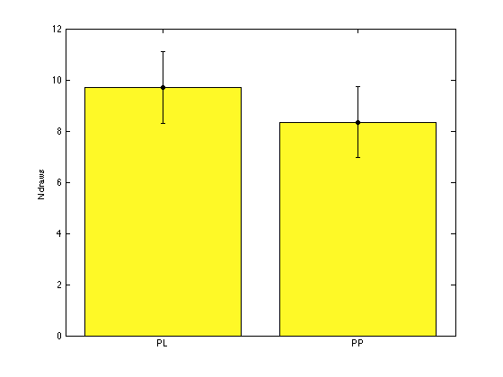
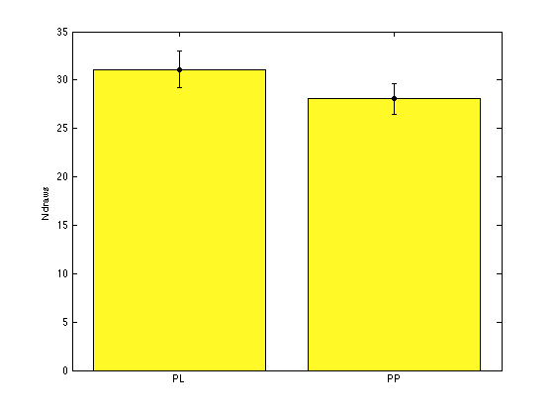
Balance in no. draws between PL and PP?
One does not see sig (p>.1) different PL-draws vs PP-draws if run on raw scores (left)
But, at bin 3, p=.07 (right)

Slide 3
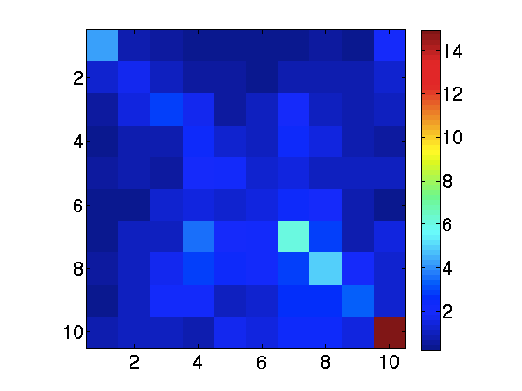
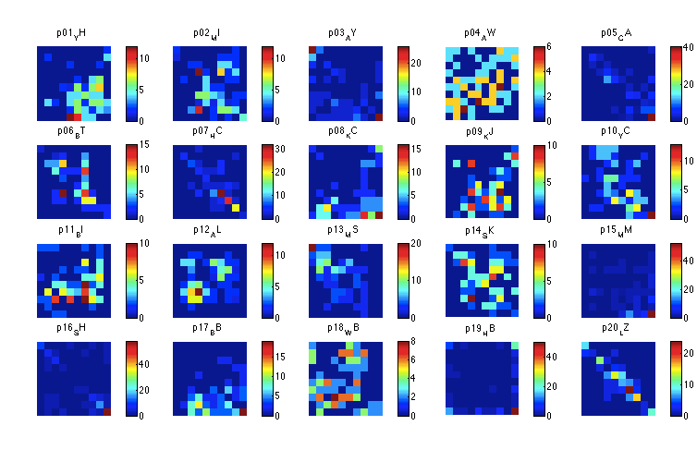
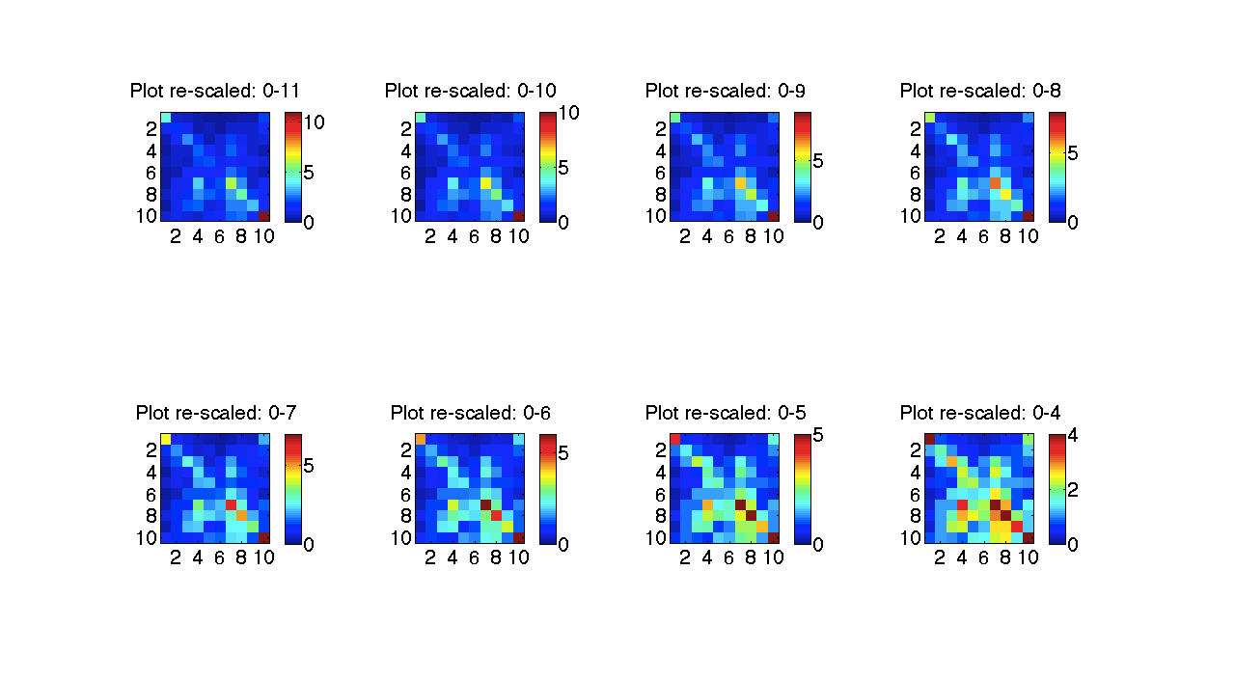
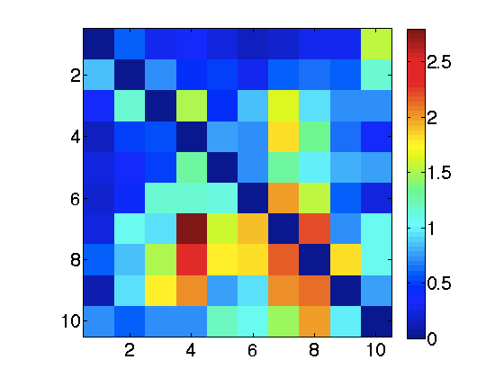
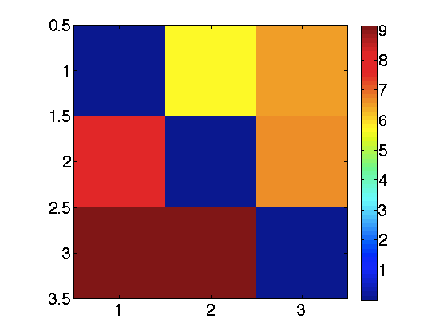
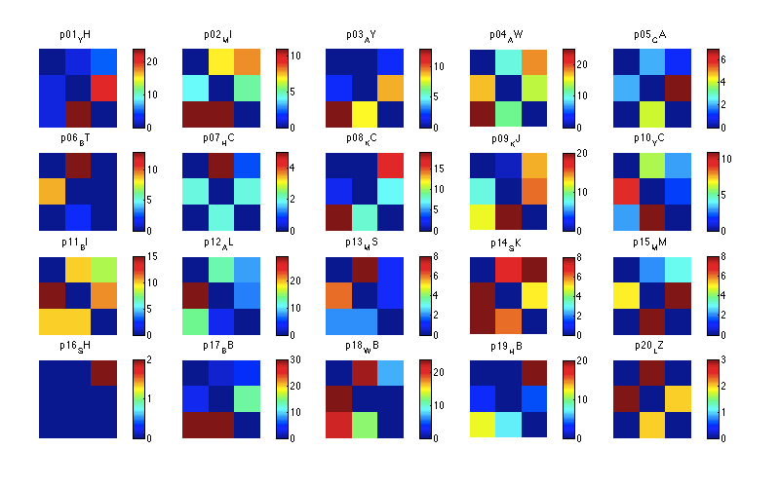
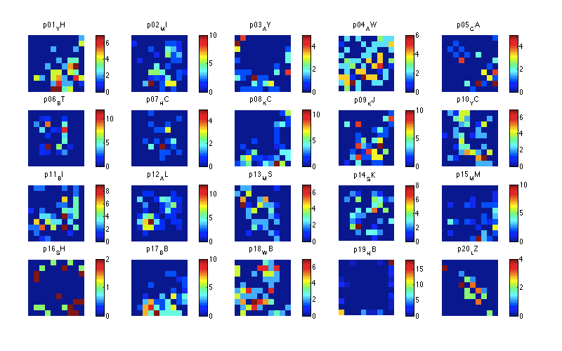
PL and PP are generally correlated w each other
Removing all trials where PL==PP for either event helps somewhat, but vastly reduces power (Mean n trials: 43.7 trials, sd=19.53)
Bin3 first, then remove all trials where PLbin==PPbin for either event: Mean n trials: 22.4, sd=13.88)

Slide 4
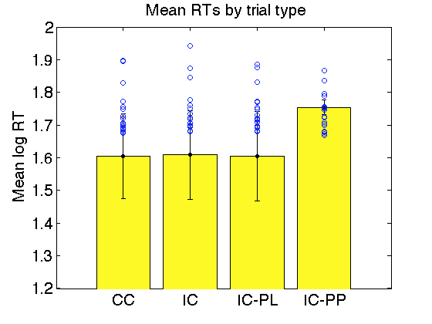
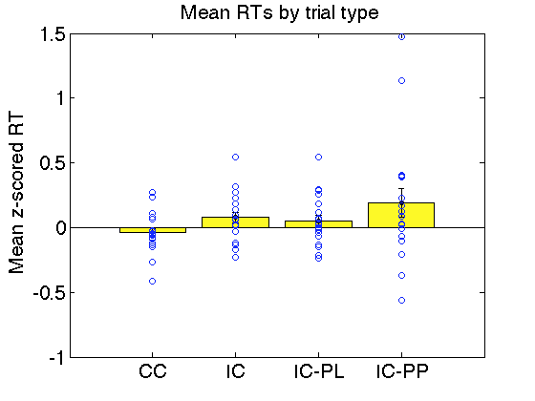
RTs
RTs do seem generally slower for IC-PP than other trials, but differences is not statistically robust
Log-RTs (non-parametric tests also nsf)
CC vs IC: t(19)= -0.32581 , p=0.74813
CC vs IC-PL: t(19)= 0.05784 , p=0.95448
CC vs IC-PP: t(18)= -1.4049 , p=0.17707
IC-PL vs IC-PP: t(18)= -1.1408 , p=0.2689
Z-scored RTs (non-parametric tests similar)
CC vs IC: t(19)= -1.7211 , p=0.10148
CC vs IC-PL: t(19)= -1.2928 , p=0.21159
CC vs IC-PP: t(18)= -1.8774 , p=0.07676 (NP: p=.047)
IC-PL vs IC-PP: t(18)= -1.0744 , p=0.29683

Slide 5
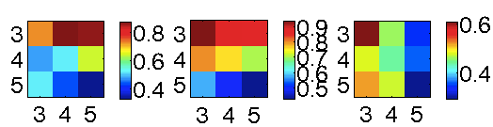
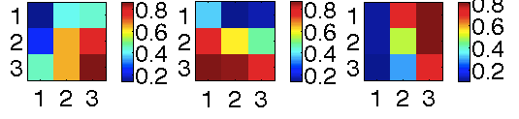
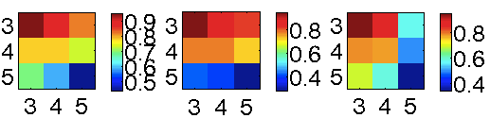
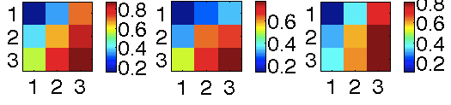
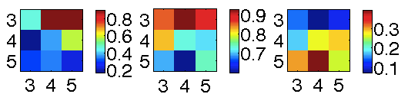
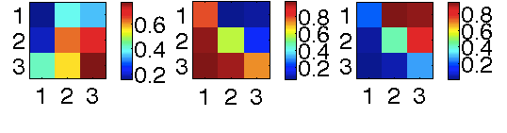
Bin cf
Observed data features to reproduce
VChosen
p(Choose agree w PLPP)
p(Choose agree w PL)
p(Choose agree w PP)
p(Choose agree w PLPP)
p(Choose agree w PL)
p(Choose agree w PP)
All trials
Compatible
Choice trials
Incompatible
Choice trials
Notes:
Data is not pre-binned. IV is binned.

Slide 6
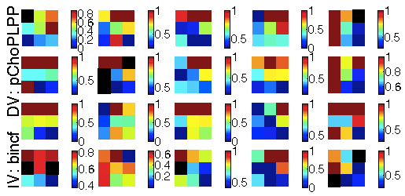
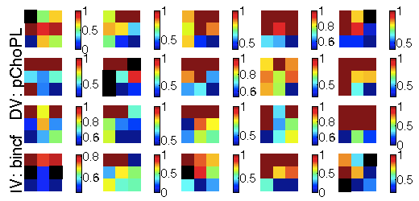
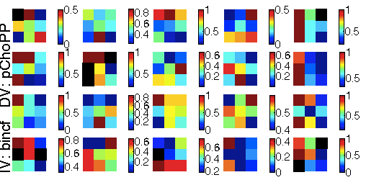
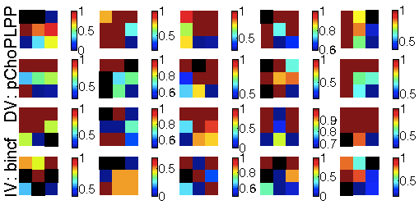
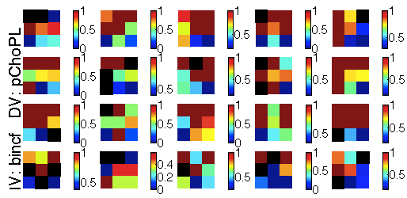
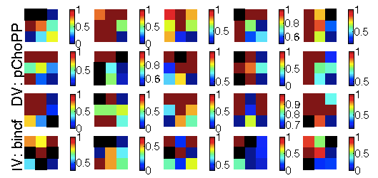
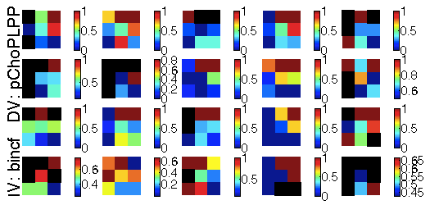
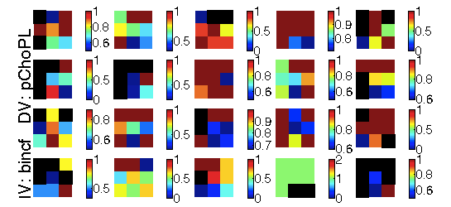
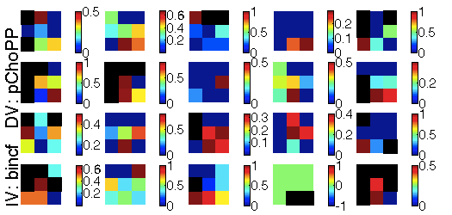
Bincf: Individual subjects
p(Choose agree w PLPP)
p(Choose agree w PL)
p(Choose agree w PP)
All trials
Compatible
Choice trials
Incompatible
Choice trials
Notes:
Data is not pre-binned. IV is binned.

Slide 7
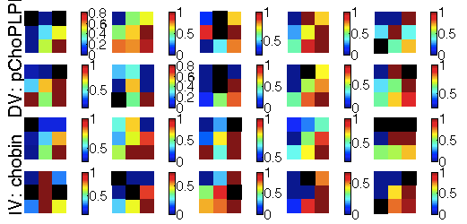
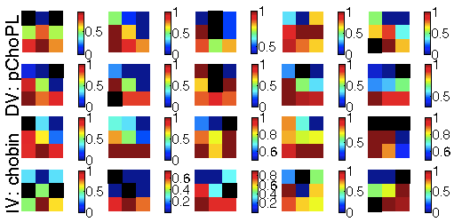
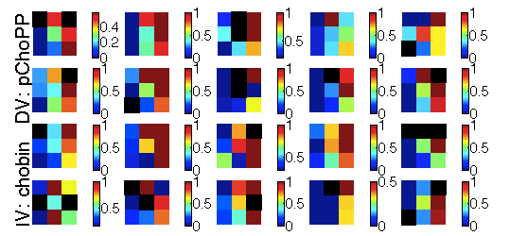
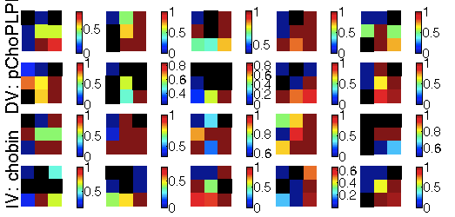
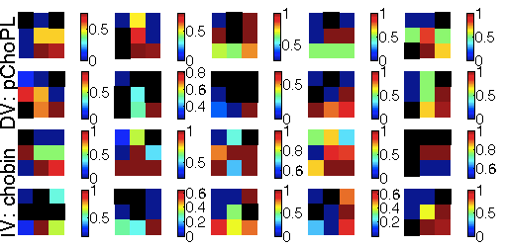
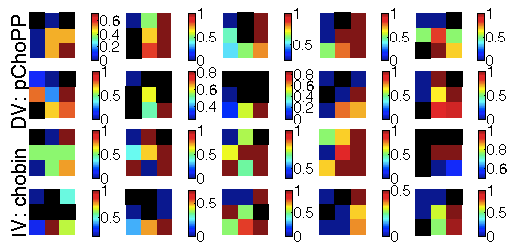
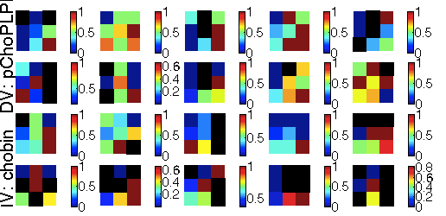
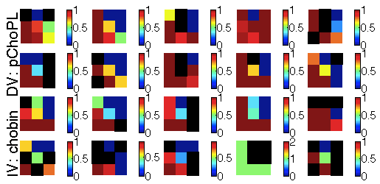
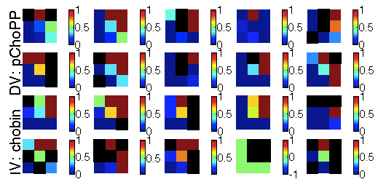
Chobin: Individual subjects
p(Choose agree w PLPP)
p(Choose agree w PL)
p(Choose agree w PP)
All trials
Compatible
Choice trials
Incompatible
Choice trials
Notes:
Data is not pre-binned. IV is binned.

Slide 8
Conflict

Slide 9
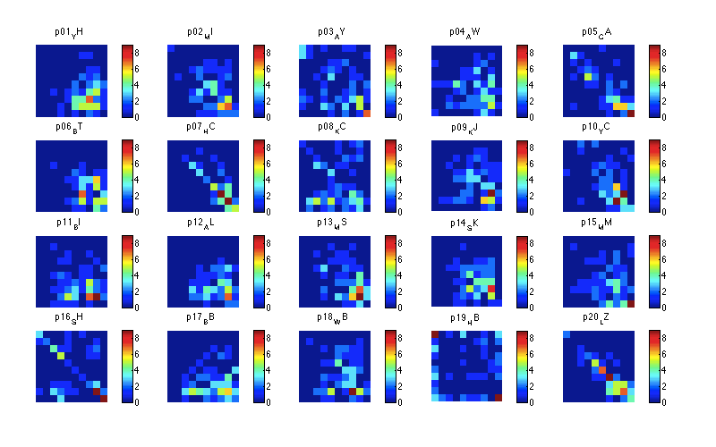
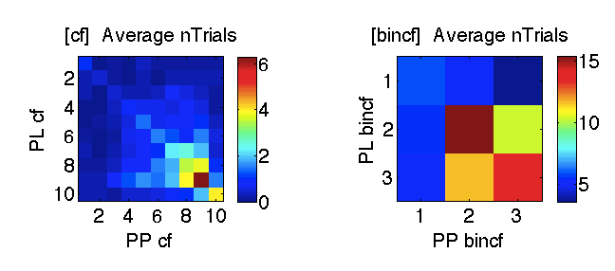
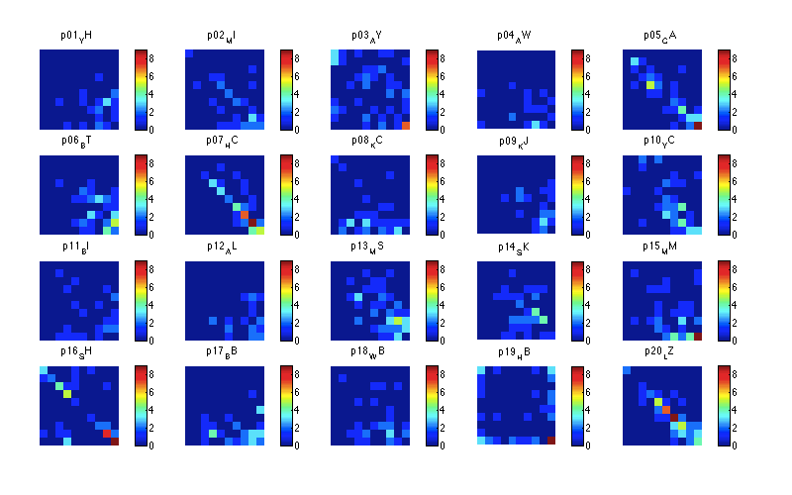
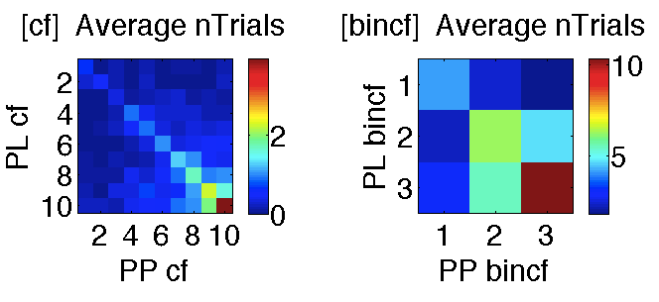
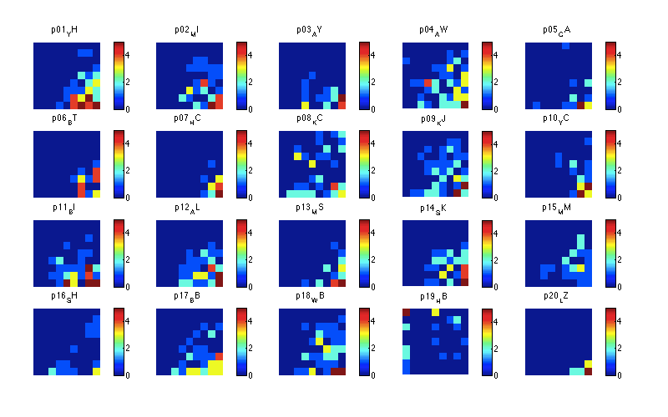
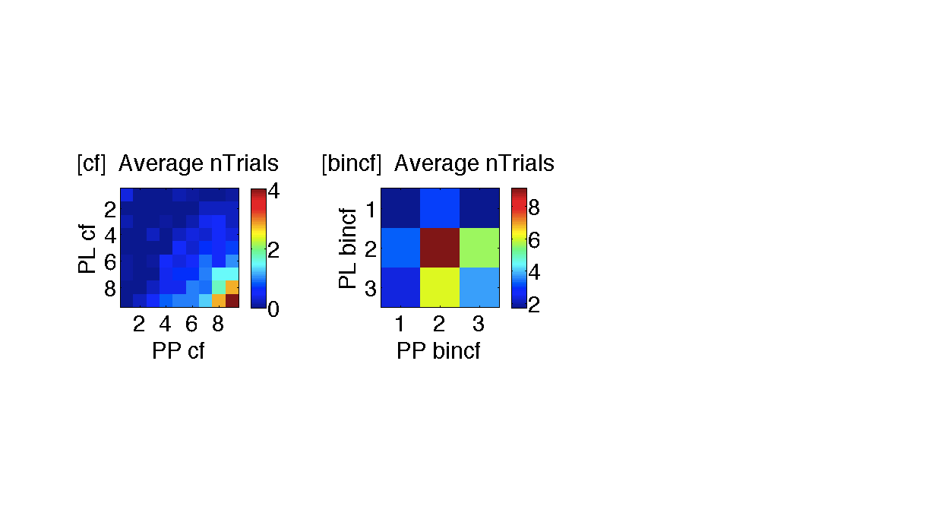
Design: N trials
All trials
Compatible Choice trials
Incompatible Choice trials

Slide 10
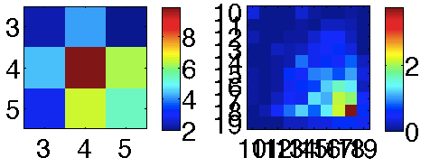
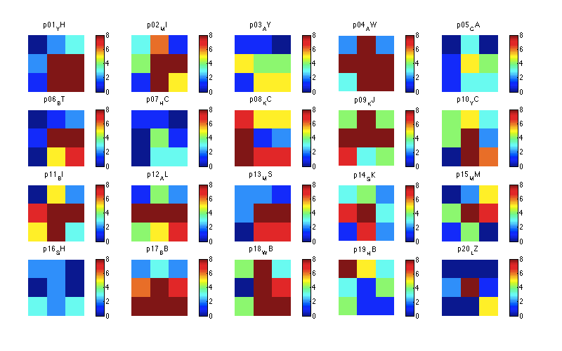
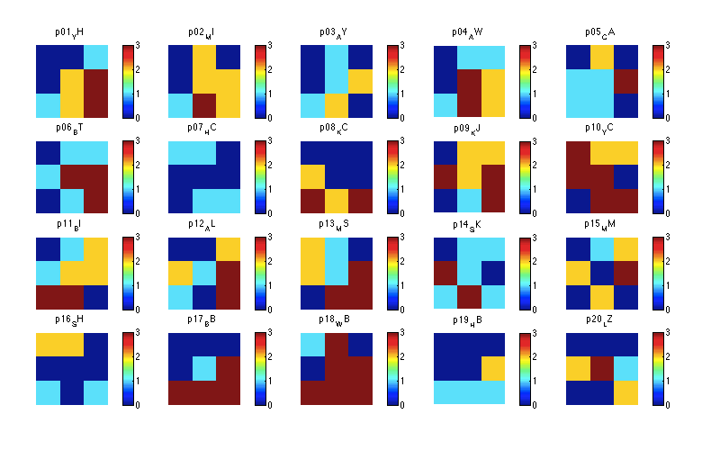
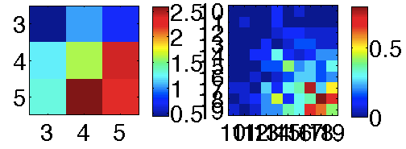
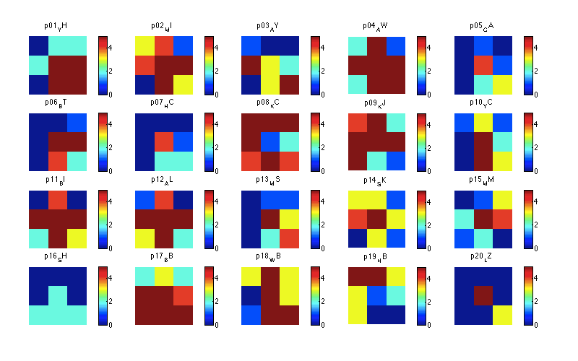
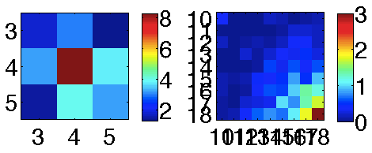
Design: N trials (deleting PL==PP)
All trials
Compatible Choice trials
Incompatible Choice trials

Slide 11
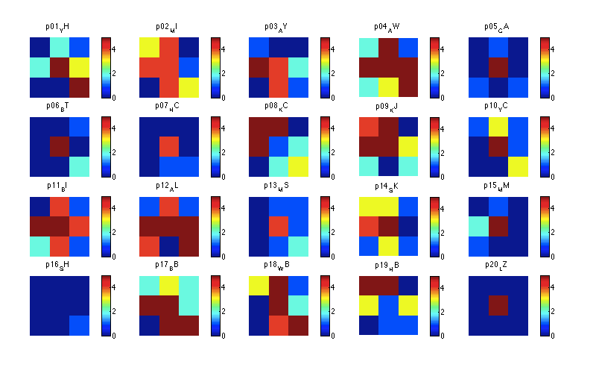
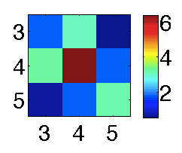
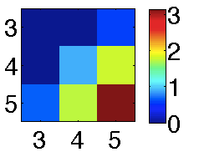


Design: N trials (deleting PL bin3==PP bin3)
All trials
Compatible Choice trials
Incompatible Choice trials

Slide 12



Choice
RTs
p(Choose agree w PLPP)
p(Choose agree w PL)
p(Choose agree w PP)
All trials
All trials
Compatible Choice trials
All trials
Chose max PL
Chose max PP
Incompatible Choice trials
Notes:
Data is not pre-binned. IV is binned.

Slide 13






Choice
RTs
Remove trials where PL==PP for any event
p(Choose agree w PLPP)
p(Choose agree w PL)
p(Choose agree w PP)
All trials
All trials
Compatible Choice trials
All trials
Chose max PL
Chose max PP
Incompatible Choice trials
Notes:
Data is not pre-binned. IV is binned.

Slide 14





Choice
RTs
Remove trials where PL bin3==PPbin3 for any event
p(Choose agree w PLPP)
p(Choose agree w PL)
p(Choose agree w PP)
All trials
All trials
Compatible Choice trials
All trials
Chose max PL
Chose max PP
Incompatible Choice trials
Notes:
Data is not pre-binned. IV is binned.

Slide 15





Choice
RTs
p(Choose agree w PLPP)
p(Choose agree w PL)
p(Choose agree w PP)
All trials
All trials
Compatible Choice trials
All trials
Chose max PL
Chose max PP
Incompatible Choice trials
Notes:
Data is not pre-binned. IV is binned.

Slide 16
VChosen (alone)

Slide 17






Design: N trials
All trials
Compatible Choice trials
Incompatible Choice trials

Slide 18


Choice
RTs
p(Choose agree w PLPP)
p(Choose agree w PL)
p(Choose agree w PP)
All trials
All trials
Compatible Choice trials
All trials
Chose max PL
Chose max PP
Incompatible Choice trials

Slide 19
Vchosen>Vunchosen

Slide 20







Design: N trials
All trials
Compatible Choice trials
Incompatible Choice trials

Slide 21






Design: N trials (deleting PLbin=PPbin)
All trials
Compatible Choice trials
Incompatible Choice trials

Slide 22






Design: N trials (deleting PLbin3=PPbin3)
All trials
Compatible Choice trials
Incompatible Choice trials

Slide 23





Choice
RTs
p(Choose agree w PLPP)
p(Choose agree w PL)
p(Choose agree w PP)
All trials
All trials
Compatible Choice trials
All trials
Chose max PL
Chose max PP
Incompatible Choice trials

Slide 24





Choice
RTs
Remove trials where PL==PP for any event
p(Choose agree w PLPP)
p(Choose agree w PL)
p(Choose agree w PP)
All trials
All trials
Compatible Choice trials
All trials
Chose max PL
Chose max PP
Incompatible Choice trials

Slide 25





Choice
RTs
Remove trials where PLbin3==PPbin3 for any event
p(Choose agree w PLPP)
p(Choose agree w PL)
p(Choose agree w PP)
All trials
All trials
Compatible Choice trials
All trials
Chose max PL
Chose max PP
Incompatible Choice trials

Slide 26
VCF

Slide 27






Design: N trials
All trials
Compatible Choice trials
Incompatible Choice trials

Slide 28






Choice
RTs
p(Choose agree w PLPP)
p(Choose agree w PL)
p(Choose agree w PP)
All trials
Chose con PL
Chose con PP
All trials
Compatible Choice trials
Incompatible Choice trials

